Slide 1
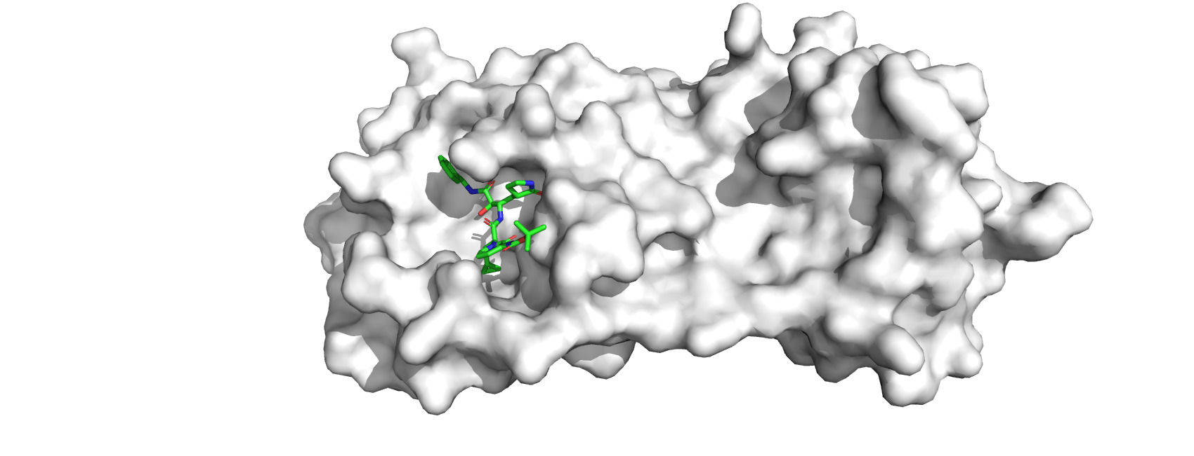
Comparative Assessment of Docking software for Virtual Screening of covid-19 drug candidates
Xi Yang (Ian)
SARS-CoV-2 Main Protease & Inhibitor
Notes:
Self-led project done during COVID;
Context: September 2020, My 3rd year UG, heard about how different drugs may be used to treat Covid, interested to find out whether that’s the case.
Then gathered interests from 7 friends, found out about comp chem from Toni Mey; keen to work on covid, so initiated the idea on drug screening;
My first computational project, only started to learn Python, but instrumental to choosing my current masters
My work: protein target identification, data analysis, stats & visualisation

Slide 2
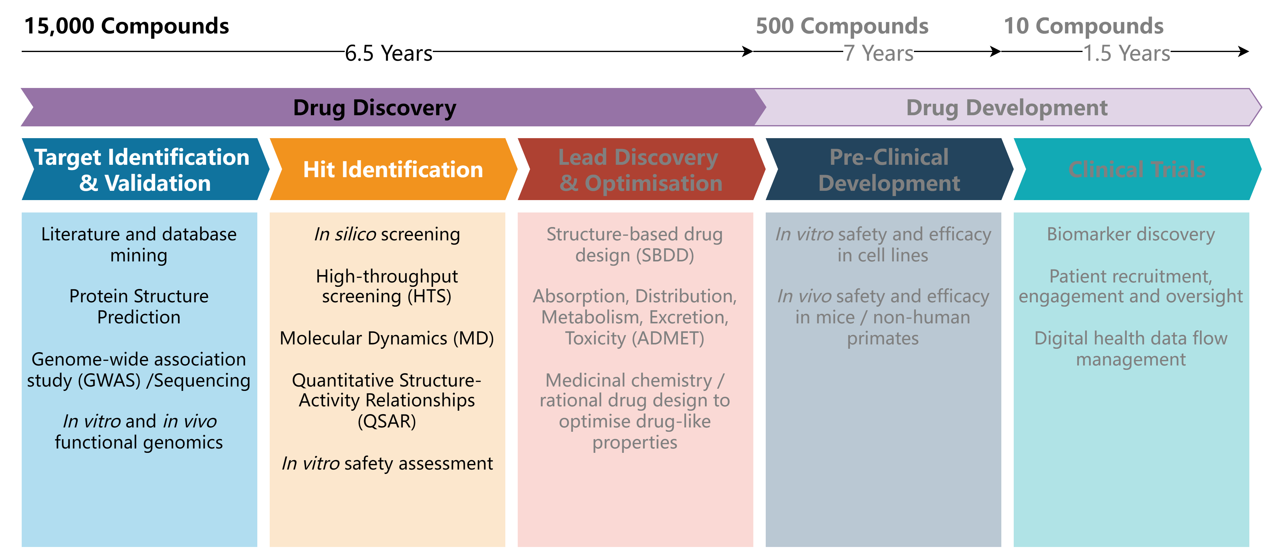
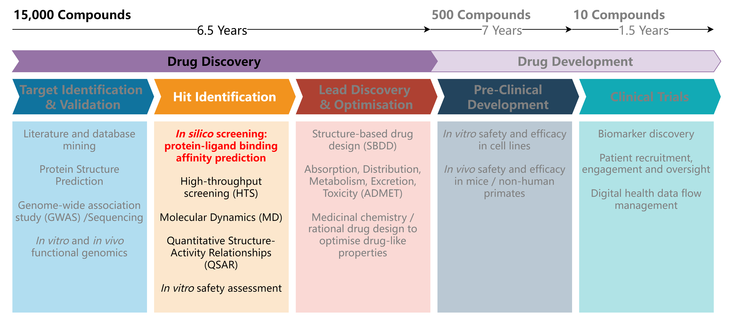
Background: Early Drug Discovery
Notes:
How it linked to a broader set of questions or the biological principles behind the project
Target iden & val; Start with 15000 compounds;
Hit molecule: shows biological activity to target;
Optimise further to get lead compounds; Development.
This project: BA predicting – how good do they bind?

Slide 3
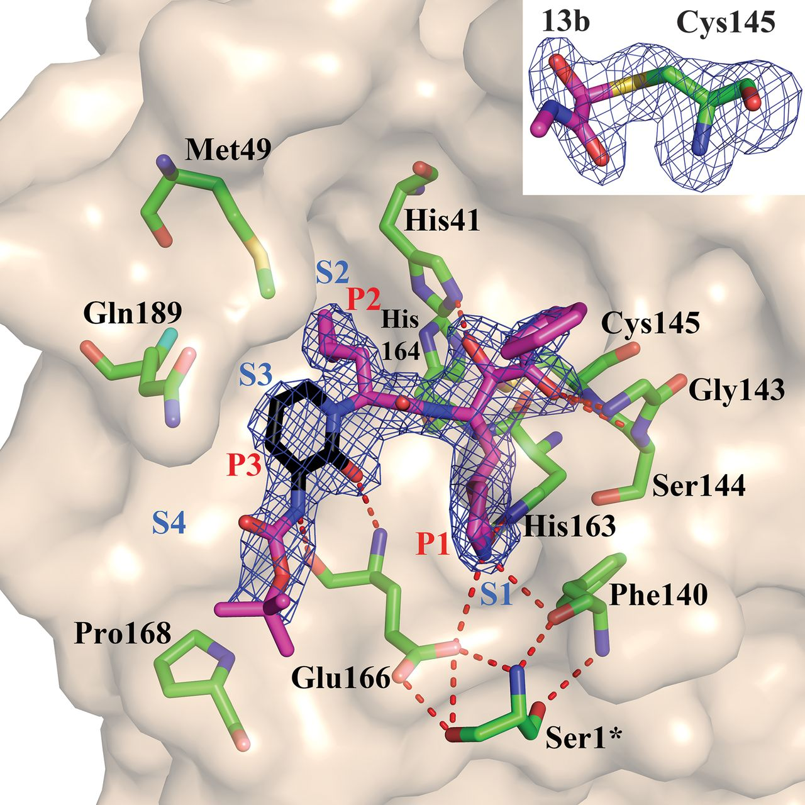
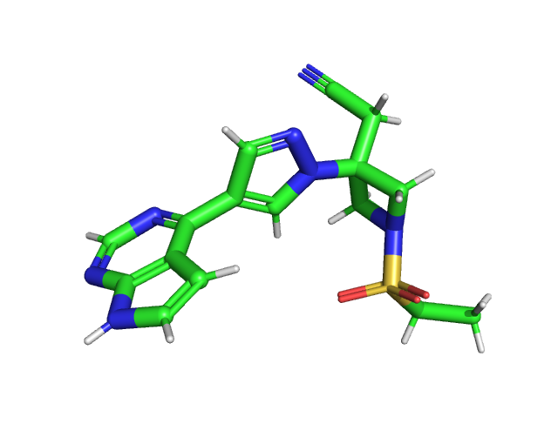
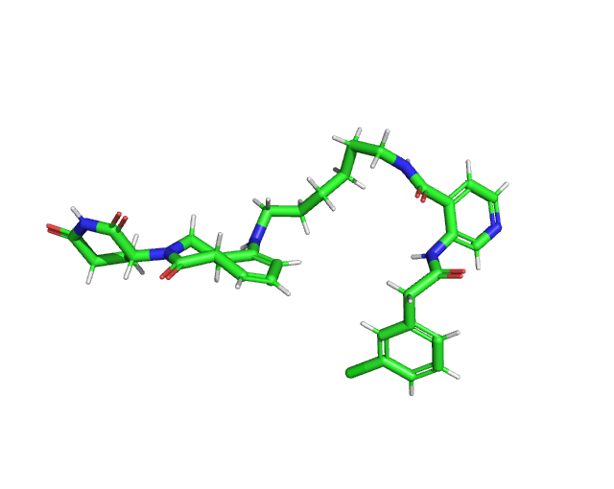
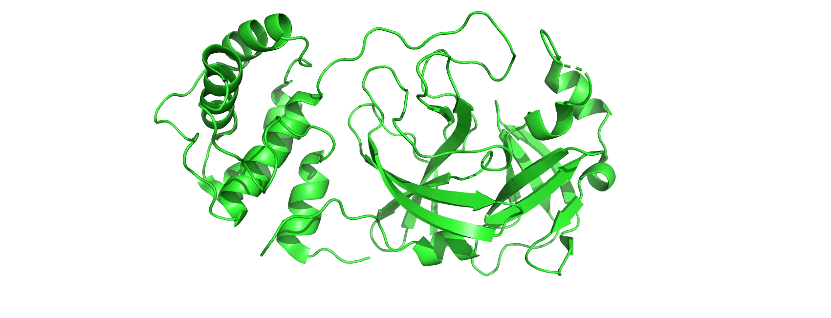
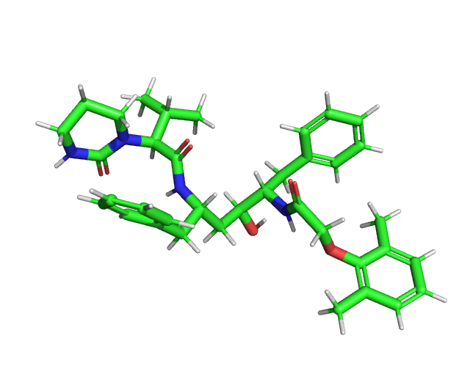
SARS-CoV-2 Main Protease: Focusing on 1 active site
Drug target: SARS-CoV-2 main protease (Mpro)
Compound library: Natural products, known inhibitors, clinically-approved drugs for other diseases (23 in total, very different scaffold)
Baricitinib (Natural Product)
DAR-DIA-9e4459de-1 (Known inhibitor – COVID Moonshot)
SARS-CoV-2 Main Protease
Active site: Sn indicate the binding pockets for moieties Pn on the ligand
(only showing 1 active site, 4 were investigated in this study)
Lopinavir (Approved drug for HIV)
Crystal structure of SARS-CoV-2 main protease provides a basis for design of improved α-ketoamide inhibitors | Science, https://www.science.org/doi/10.1126/science.abb3405, (accessed 1 May 2024)
Notes:
Target: Mpro, a protein, viral replication regulation; if a compound can inhibit then we can cure COVID
Many active sites on Mpro.
Active site: potent inhibitor shown experimentally to inhibit Mpro, showing the side chains that the ligand interacts with;
Compound library consists of 23 molecules

Slide 4
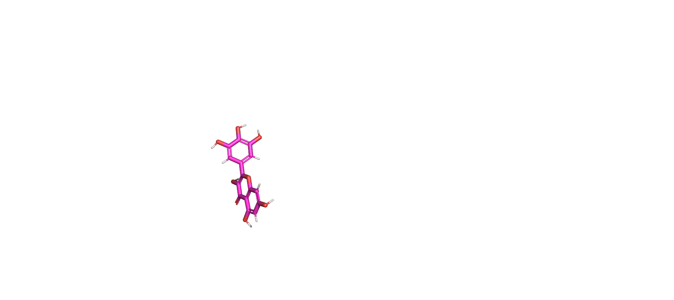
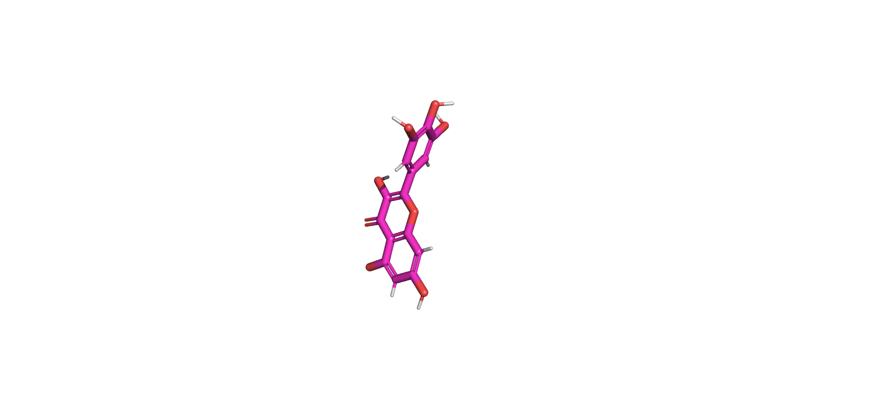
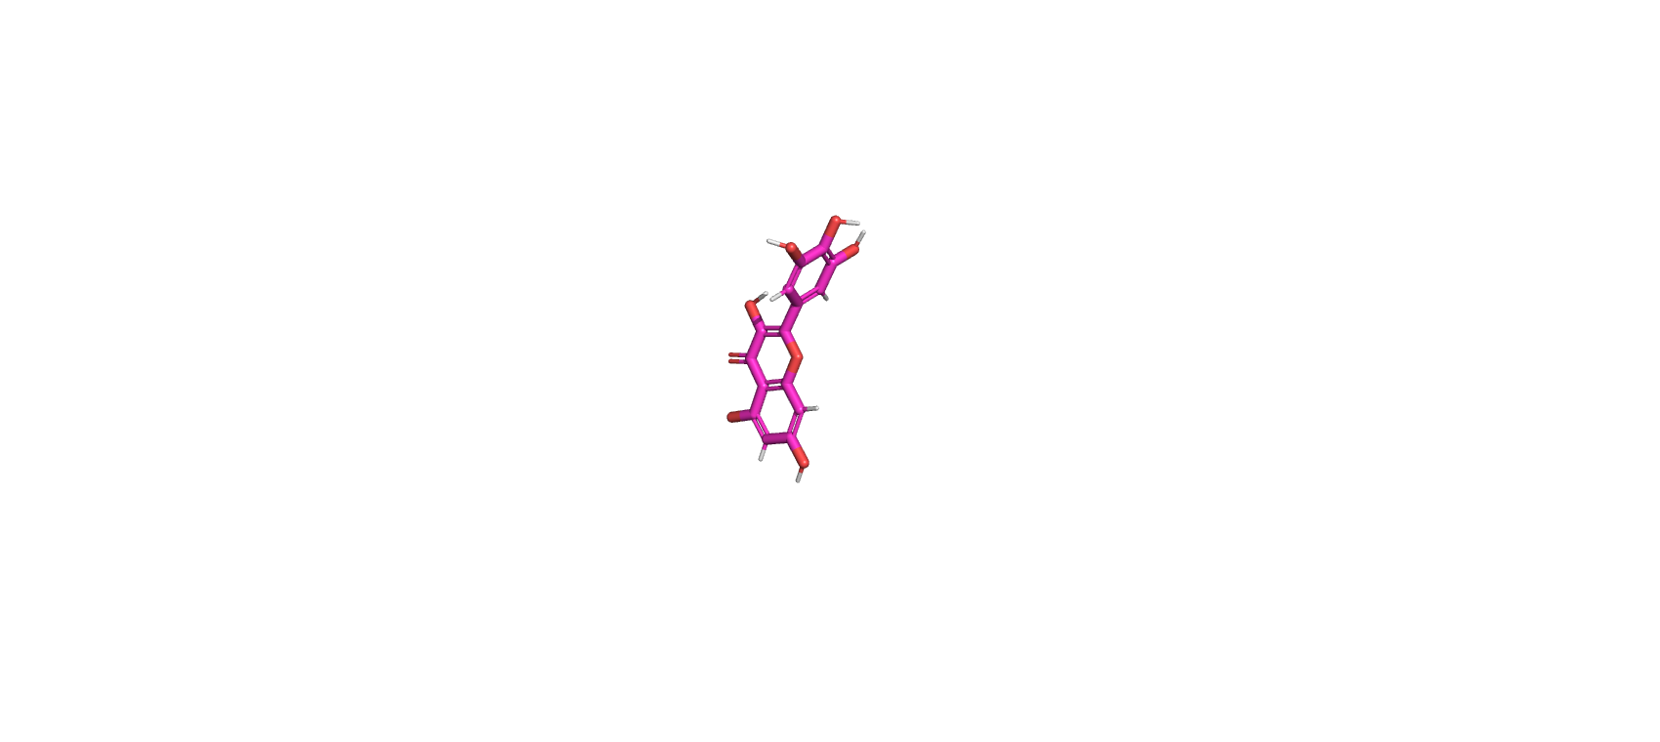
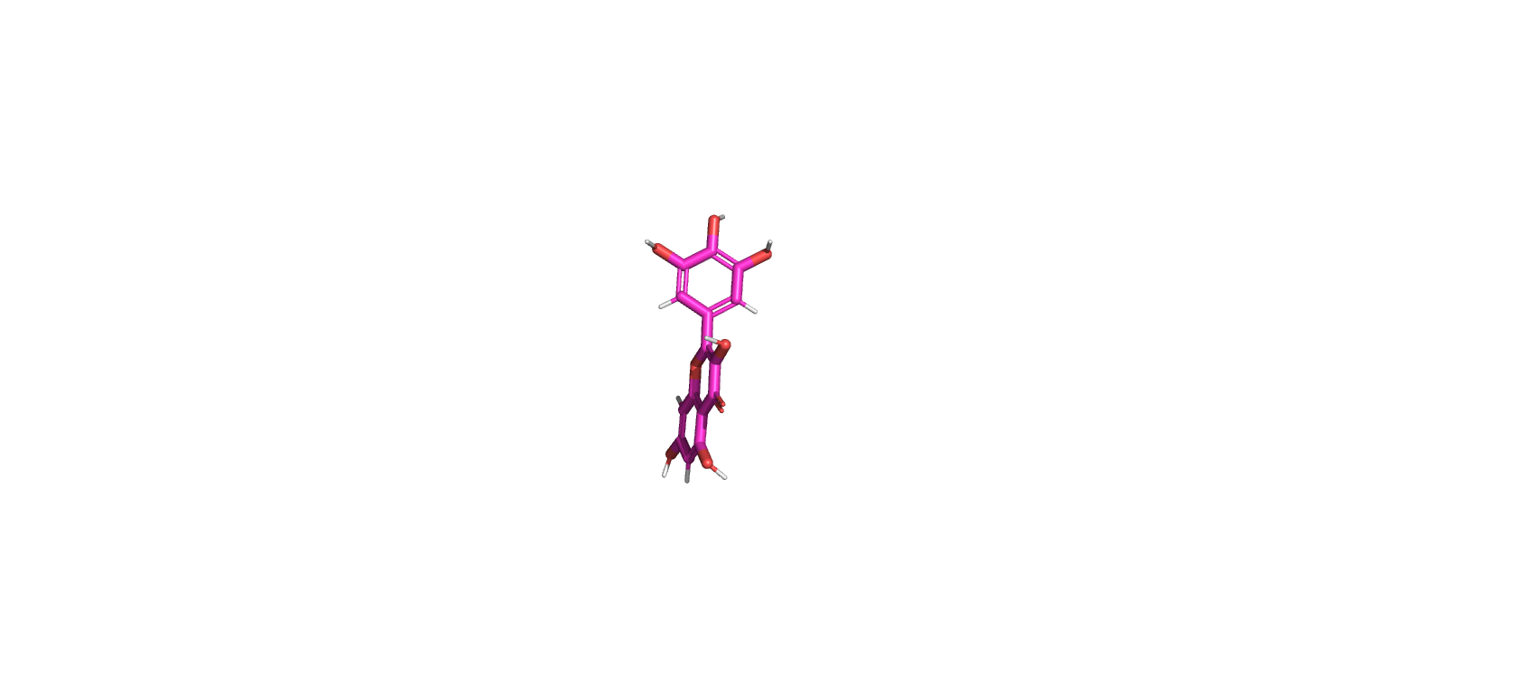
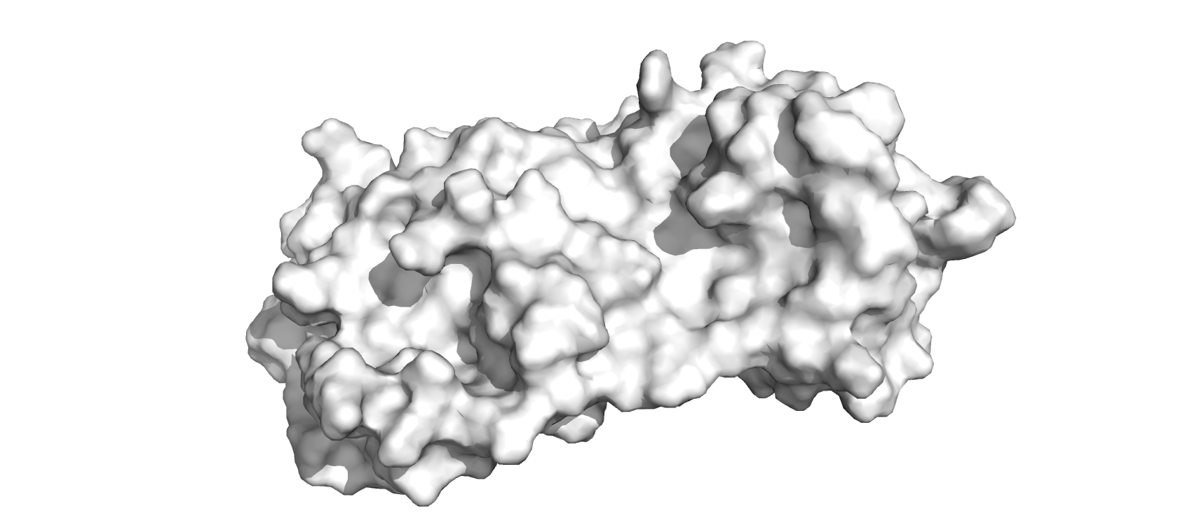
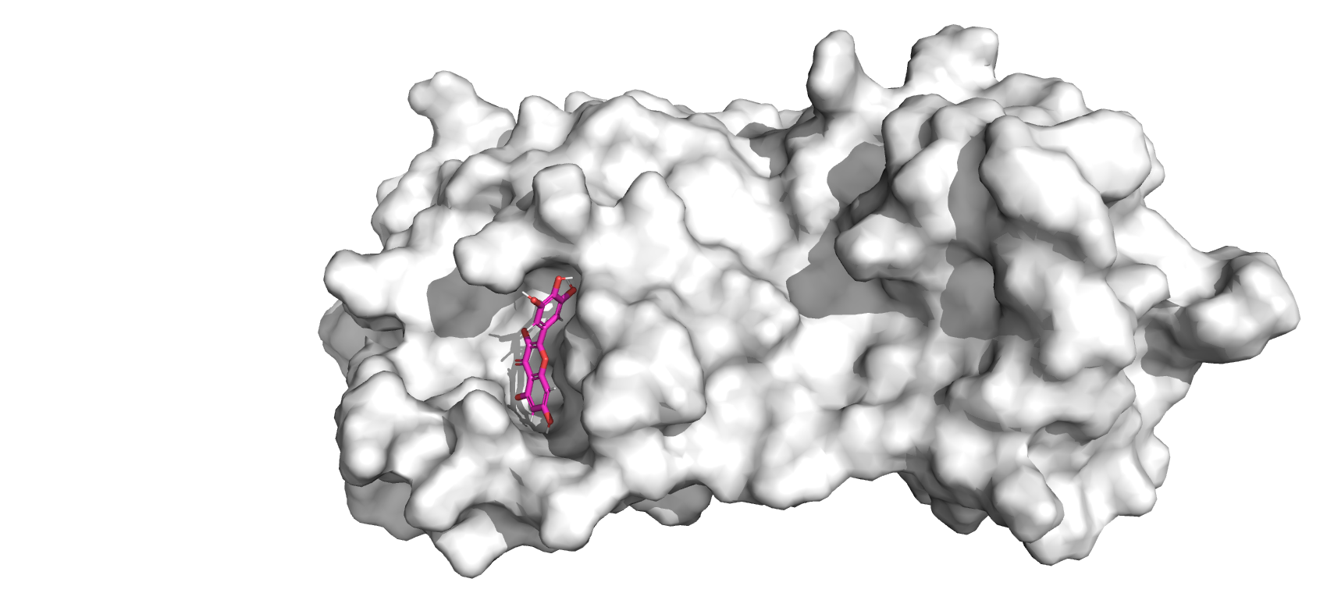



My Project: Binding Affinity Prediction
Binding Affinity K_{d}: how strong is the protein-ligand interaction?
Quick scoring: molecular docking
Protein is assumed static in docking
Slow scoring: physics-based computations
Comparison between 3 docking software:
Docking algorithm: suggests ligand poses
Scoring function: predicts binding affinity
Different poses of one ligand
Software
Autodock Vina
rDock
Flare
+
K_{d}
Binding affinity predicted by a scoring function
Notes:
How I addressed the main research questions
Binding Affinity: How strong the protein-ligand interaction is
Quick scoring: molecular docking using GAs
Slow scoring: physics based, computationally expensive, accurate
A docking algorithm: predict the preferred orientation of a ligand when bound to a protein pocket. It aims to simulate the formation of stable complexes between ligands and protein. Generate 10 molecules, rank in terms of dG.
Scoring function: evaluates the strength of the binding interaction between a protein pocket and its ligand.
We compare 3 docking software against each other, each is different in their algorithm/scoring
Knowledge-based: stat data from known complexes to predict interactions in new complexes.
Empirical-based: Fitting maths models to exp data, to take into account physical interactions e.g. H-bonds, hydrophobic effects, VDW, electrostatic interactions; others: polar, desolvation

Slide 5
Binding Affinity Prediction: Compare between 3 docking software
Software | Scoring Function | Docking Algorithm
Autodock Vina | Knowledge-based + empirical | Genetic algorithm + Quasi-Newton (BFGS)
rDock | Empirical | Genetic algorithm + Monte Carlo
Flare | Knowledge-based + empirical | Genetic algorithm + Pseudo Solis-Wets (PSW) optimisation
M. E. Buckley, A. R. N. Ndukwe, P. C. Nair, S. Rana, K. E. Fairfull-Smith and N. S. Gandhi, Comparative Assessment of Docking Programs for Docking and Virtual Screening of Ribosomal Oxazolidinone Antibacterial Agents, Antibiotics (Basel), 2023, 12, 463.
Flare Docking, https://nodepit.com/node/com.cressetgroup.knime.nodes.flare.docking.DockingNodeFactory, (accessed 1 May 2024)
Notes:
Knowledge-based: stat data from known complexes to predict interactions in new complexes.
Empirical-based: Fitting maths models to exp data, to take into account physical interactions e.g. H-bonds, hydrophobic effects, VDW, electrostatic interactions; others: polar, desolvation

Slide 6
BFGS (Broyden-Fletcher-Goldfarb-Shanno): numerical optimisation, approximates the gradient of the function to make smart guesses about the direction to head towards next to approach the optimal point more quickly. (similar to gradient descent).
Monte Carlo optimisation: repeatedly sampling from a probability distribution that represents the uncertainty or variability of the problem parameters
Pseudo Solis-Wets (PSW): numerical optimisation, generates random perturbations around the current solution, adjusting these perturbations based on their success in improving the objective function, and dynamically modifying the variance of these perturbations.

Slide 7
Scoring Functions
Knowledge-based: stat data from known complexes to predict interactions in new complexes.
Empirical-based: Fitting maths models to exp data, to take into account physical interactions e.g. H-bonds, hydrophobic effects, VDW, electrostatic interactions; others: desolvation upon binding
Notes:
Three distinct scoring functions are available within Lead Finder, based on a semi-empiric molecular functional that explicitly accounts for various types of molecular interactions. Empiric coefficients are used to scale the individual energy contributions and produce three scoring functions:
•Ranking scoring function, or Rank Score: this function is used for ranking ligand poses obtained during a docking run. The purpose of this function is to reproduce experimentally observed ligand poses as well as possible
•dG-scoring function, or dG score: this scoring function has been designed to perform accurate estimation of the free energy of protein-ligand binding for a given protein-ligand complex. The scaling coefficients for this function have been derived by fitting calculated binding energies to the experimental values for a set of 100 protein-ligand complexes with known 3D structure and experimentally measured binding constants
•Virtual screening (VS) scoring function, or VSscore: this function has been designed to produce maximum efficiency in virtual screening experiments i.e. to assign higher scores to active ligands (true binders) and lower scores to inactive ligands.
All the above functions include the same set of energy contributions but weighted with different coefficients. A brief description of the energy terms included in Lead Finder scoring functions is provided below:
•Van der Waal interactions are calculated with a 6-12 Lennard Jones (LJ) potential, while the interactions with metals are calculated with a 10-12 LJ potential. The parameters for calculating LJ for standard atom types (O, N, C, H, CA - aromatic carbon, NX – nitrogen that cannot accept hydrogen bonds, P, S) were taken from the CHARMM19 force field, while some modifications were introduced for better representation of united atoms. The parameters for halogen atoms were taken from OPLSAA and re-optimized.
•Protein-ligand electrostatic interactions are calculated using the screened Coulomb potential (SCP) with distance- and microenvironment dependent dielectric permittivity. The energy of the electrostatic interactions is calculated as:
Where h_{i} is the hydrophilicity of a microenvironment of atom i, b_{i} is its buried fraction, q_{i} and q_{j} are the partial atomic charges and r_{ij} is the interatomic distance. The ligand partial atomic charges are calculated with Gasteiger algorithm.
•The energy of electrostatic interaction is calculated using the formula:
Where D_{n} is a screening function describing distance dependence of dielectric permittivity.
•The polar electrostatic contribution of ligand desolvation upon binding to protein is evaluated using an adapted version of the Born model with the formula:
Where D_{ES}(R_{B,i}) is the dielectric screening calculated at the distance R_{B,i} (Born radius of atom i) from the center of the ligand atom in the protein-ligand complex, and D_{W}(R_{B,i}) denotes dielectric screening calculated at the distance R_{B,i} in water.
•Hydrogen-bonding energy contribution is calculated as a sum of energies of individual hydrogen bonds (H-bonds) formed between protein and ligand (E_{hb}) and energetic penalties arising from H-bonds donors and acceptors in protein and ligand which did not form H-bonds in the complex:
Where the energy of the individual H-bonds is:
The coefficient k(h_{i}) depends on the hydrophobicity of the particular H-bond microenvironment.
•The non-polar solvation contribution, which is favored by hydrophobic contacts in the protein-ligand complex is accounted in a classical volume-based fashion:
where summation runs over all protein and non-hydrogen ligand atoms and S_{i} and V_{i} denote atomic solvation parameters, and r_{ij is the} interatomic distance.
•Internal energy losses of the ligand upon transition from the solvent to the protein-bound state are accounted by comparing the ligand internal energies in conformations typical for the solution and protein bound state:
Where k_{nb} and k₁₋₄ are scaling constants for non-bonded (van der Waals) and 1-4 interactions. The first term in the sum is the difference of non-bonded energies of ligand in protein-ligand complex and water, and the second term is the same difference of 1-4 interaction energies.
•The Entropic losses accounting for freezing ligand’s degree of freedom upon binding to protein are calculated in a standard linear fashion:
Where n_{tors} is the number of freely rotatable bonds (FRB) in the ligand and k_{tors} is a scaling factor fitted with the training set.

Slide 8
Docking Algorithms and why they can be random
The genetic algorithm comprises the following steps:
1.Generation of the initial pool (population) of individuals, randomly (this can cause drastically different ligand poses and local minima!)
2.Until convergence of population is achieved:
a)Common operators (crossover, mutations, optimisations) are applied
b)Specific operators (crossover with individuals from elite niches, etc) are applied
c)Individuals are divided into niches
d)Individuals are selected for further rounds of evolution
3.Docked poses are optimised, ranked and ∆G-score is calculated
Result → one ligand can present several local minima even when only using 1 software!
Notes:
AutoDock employs an empirical scoring function based on the Free Energy Force Field, which includes terms for van der Waals interactions, hydrogen bonds, electrostatics, and desolvation. The Monte Carlo search algorithm with a simulated annealing approach is used for optimization, guided by these energy calculations​ (MDPI)​.
rDock uses a physics-based scoring function that emphasizes speed. It includes terms for van der Waals interactions, hydrogen bonds, and electrostatics, and employs a genetic algorithm for efficient conformational searching and docking​ (MDPI)​.

Slide 9
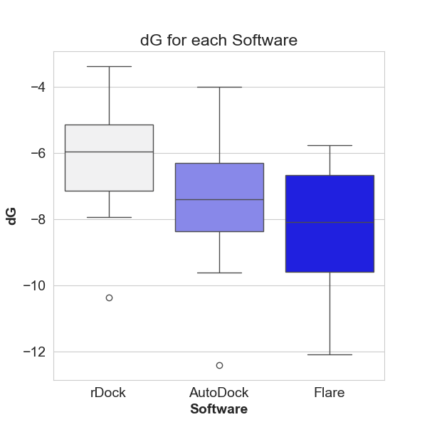
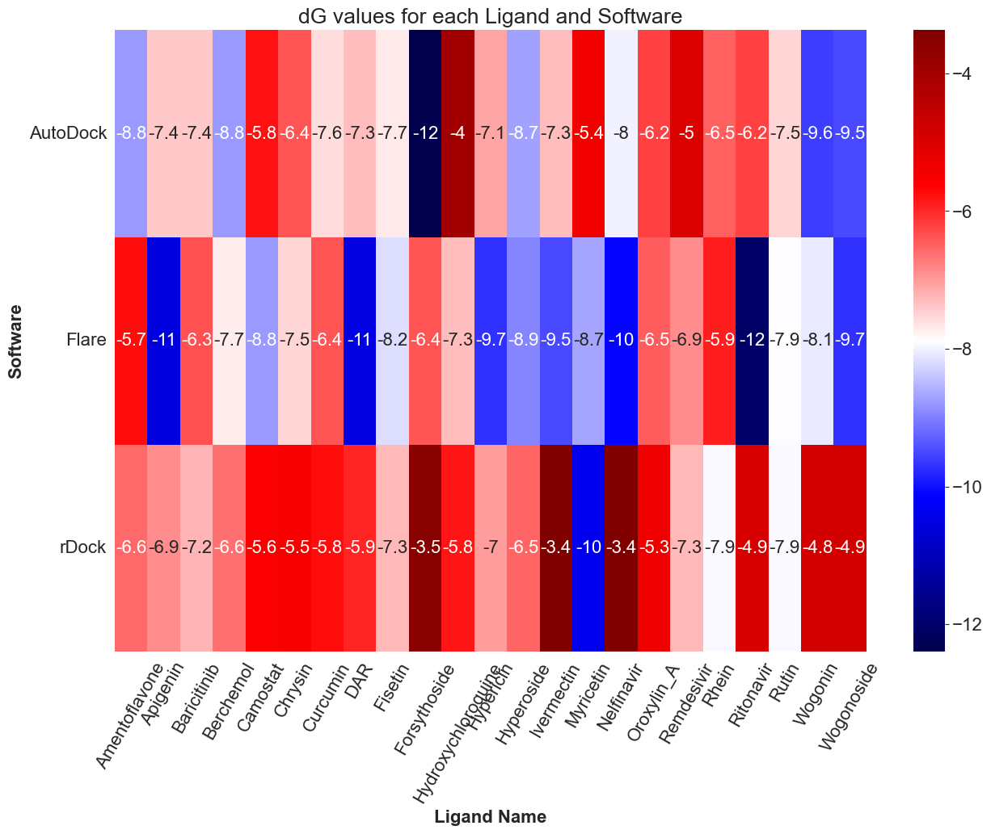
How do dG results differ from software to software?
Free Energy of Binding (dG): Lower dG = higher binding affinity K_{d}
rDock scores ligands more harshly
Flare scores ligands more favourably
Pair | Independent t-test p-value
AutoDock-Flare | 0.12
AutoDock-rDock | 0.012
Flare-rDock | 0.000091
Significantly different predictions
Notes:
Heatmap: dG, more negative = better.
As we can see on heatmap, rDock scores ligands more harshly whereas Flare scores ligands more favourably.
Boxplot to confirm, : rDock, more harshly scored;
Flare – score ligand favourably
T-test results shows significant differences between AutoDock-rDock, Flare-Rdock, but not AutoDock-Flare

Slide 10
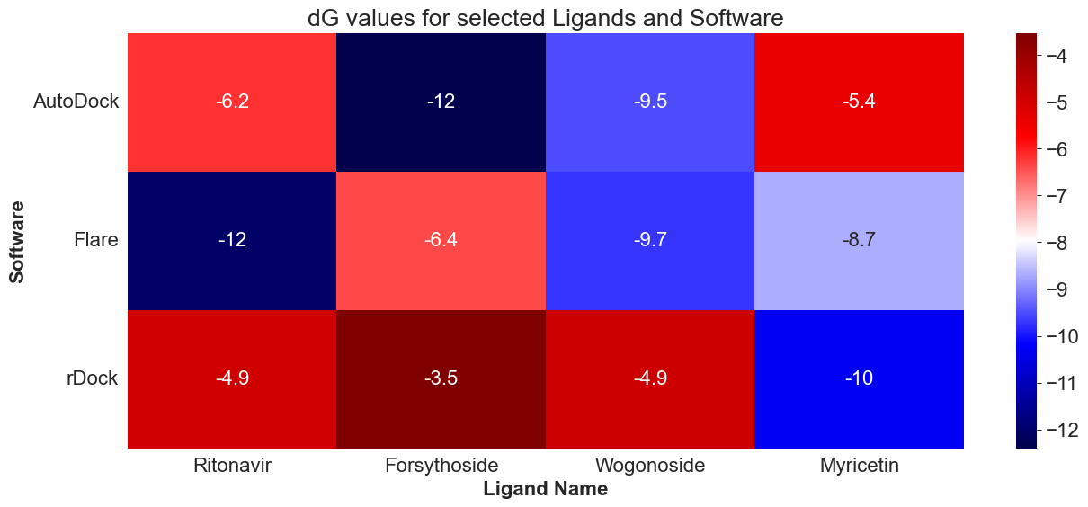
4 ligands (out of 23)
Free Energy of Binding (dG): Lower dG = higher binding affinity K_{d}

Slide 11
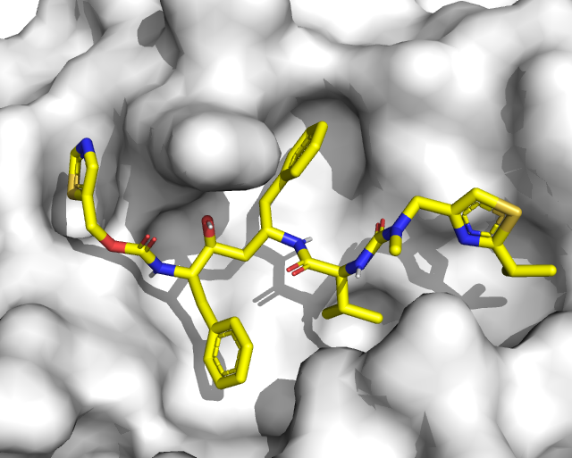
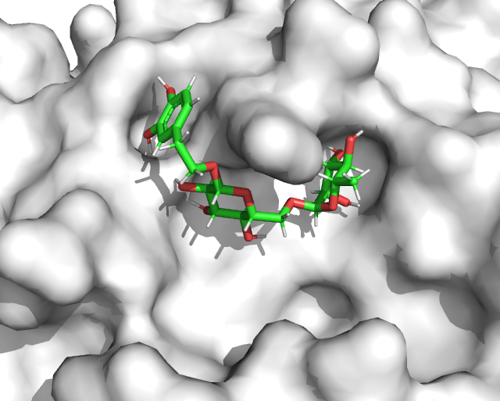
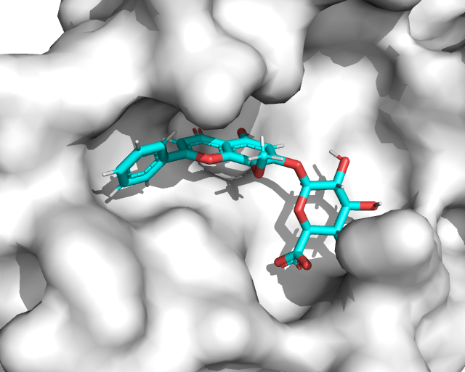
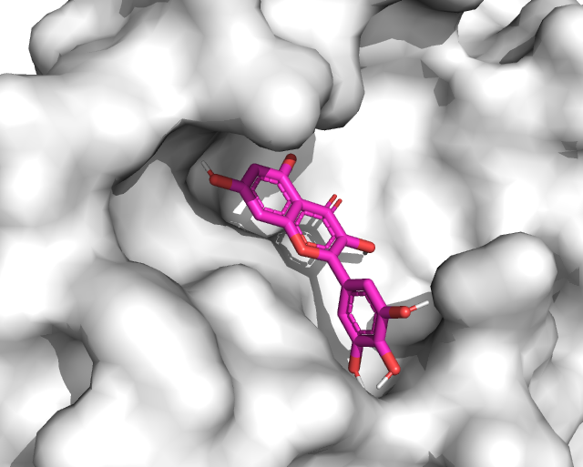
Ligands with lowest predicted dG
Ritonavir (HIV drug)
dG = - 12 kcal/mol in Flare
Forsythoside (Natural product)
dG = -12 kcal/mol in AutoDock
Wogonoside(Natural product)
dG ~ -9.7 kcal/mol in Flare
Myricetin (Natural product)
dG ~ -10 in rDock
Increasing dG (worse binding affinity)
Notes:
4 ligands as examples, showing low to high dG;
By examining the shape complementary, we can get an idea of how well the ligand can fit into the protein pocket and hence their interactions.
4 Shape complementary between ligands and the protein pocket, less so for higher dGs

Slide 12
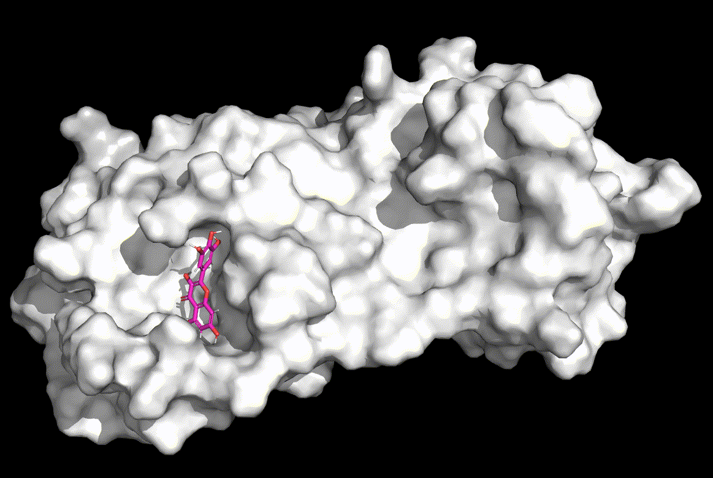
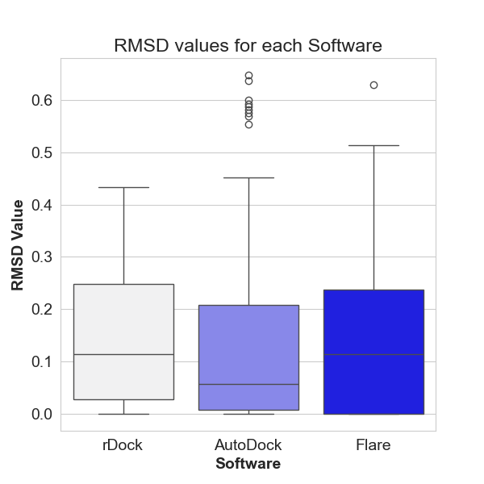
Performance of Software
Each docking algorithm suggests several ligand poses
RMSD: Measures differences in coordinates with the best ligand pose (lowest dG)
Ligand poses of myricetin suggested by Flare
Pair | Mann-Whitney U test p-value
AutoDock-Flare | 0.44
AutoDock-rDock | 0.10
Flare-rDock | 0.47
No significant difference between software performances
Notes:
Each software suggests several ligand poses, ranking from low to high dG
Wondering: how well do they map onto each other? i.e. how well does the docking algorithm perform to CONSISTENTLY get high-binding ligand poses?
RMSD
All RMSD values across all software are very good! (typically <2.5 is good)
Stat tests done, no significant difference;
Shapiro test for determining normal/non-normal distribution:
Autodock p-value: 1.5156280703675258e-14
Flare p-value: 7.153305031648571e-11
rDock p-value: 6.672721610812005e-06

Slide 13
General usability of the software?
Software | Pros | Cons
Flare | Intuitive, beginner-friendly GUI with built-in PyMol Max ligand poses: 10 | Paid, commercial software Computationally resource-intensive
AutoDock | Max ligand poses: 20 Open-source No excessive computational resource required | GUI (AutoDockTools) and command-line
rDock | Open-source No excessive computational resource required | Primarily command-line based Max ligand poses: 4
Notes:
Further questions to evaluate;
COMMENT ON EACH ONE
Usability of the software depends on available resources and knowledge.

Slide 14
Conclusion & Future Work
Cannot determine which is better (based on RMSD results).
Future work
Screening against a much larger compound library e.g., a few thousand molecules
Benchmarking against existing experimental values
Physics-based computations: Molecular Dynamics (MD) simulation
Consensus scoring: consider multiple scoring functions
Notes:
Each one has its own pros and cons, RMSD shows they’re all the same

Slide 15
My Learning
Python and Bash scripting for automating a virtual screening workflow
Evaluating docking software/algorithms through statistical analysis
Data analysis & visualisation
Consolidation for future research direction: computational biology
Teamwork: e.g., everyone has a different way of recording data, so communication is key to avoid oversights
Project management skills
Notes:
specific personal/research/professional skills you used or developed
how it related to other work you have previously carried out, or future research aspirations.

Slide 16
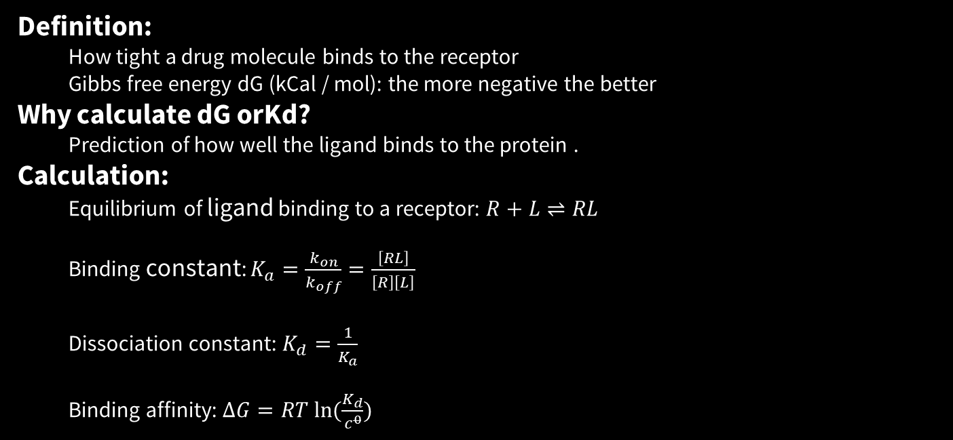
Definition:
How tight a drug molecule binds to the receptor
Gibbs free energy dG (kCal / mol): the more negative the better
Why calculate dG orKd?
Prediction of how well the ligand binds to the protein .
Calculation:
Equilibrium of ligand binding to a receptor: $R+L⇌RL$
Binding constant: $K_{a}=\frac{k_{on}}{k_{off}}=\frac{\left[RL\right]}{\left[R\right]\left[L\right]}$
Dissociation constant: $K_{d}=\frac{1}{K_{a}}$
Binding affinity: $∆G=RT ln⁡(\frac{K_{d}}{c^{0}})$

Slide 17
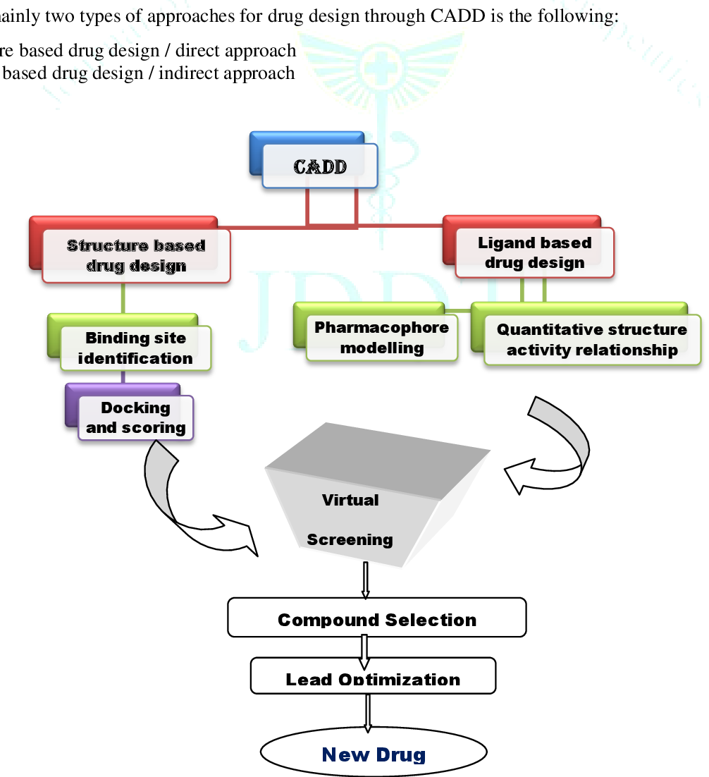
CADD

Slide 18
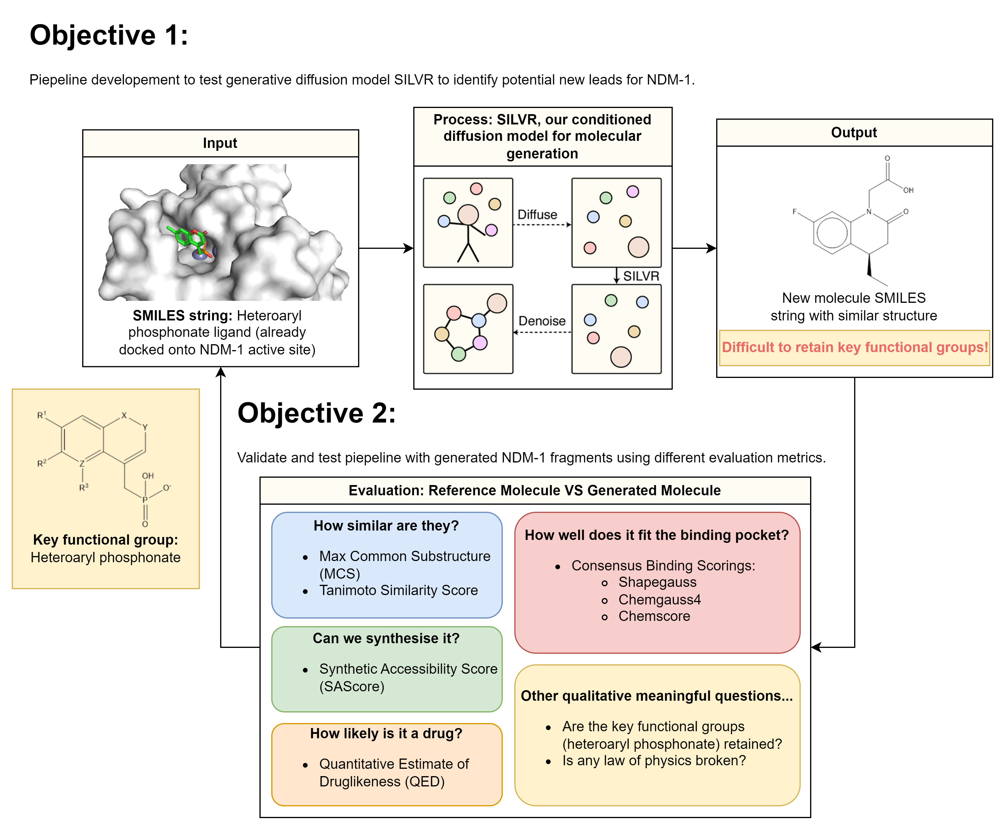

Slide 19
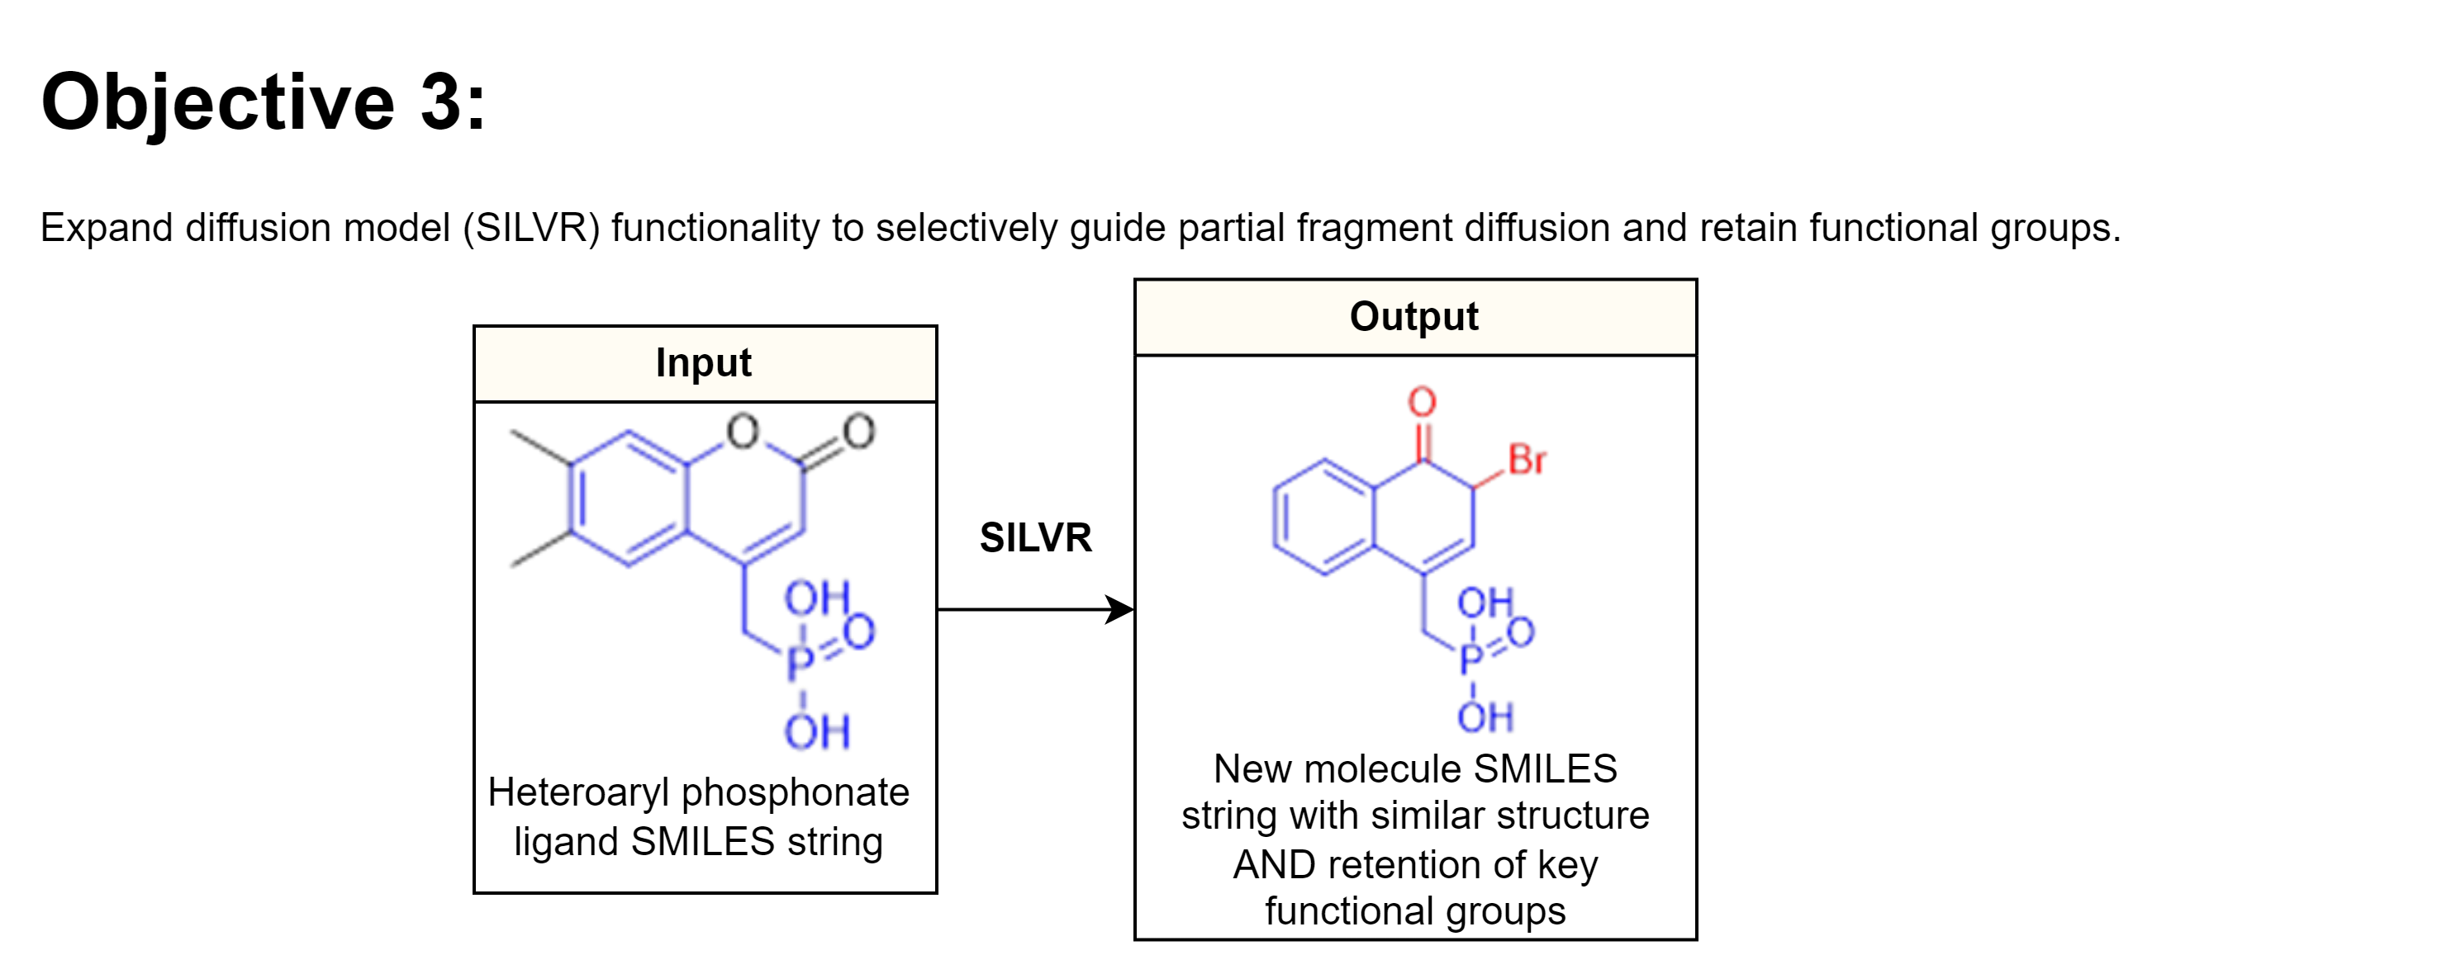

Slide 20
Is binding affinity the only thing we need to care about?
No, there’s other things to calculate & measure:
DMPK
IC50/EC50

Slide 21
Understanding stochastic metabolic oscillators in single cells
Significance:
Background:
Objective

